Slide 1
Classes in OOP
Classes are constructs/templates that define objects of the same type.
A class uses Variables (data fields) to define state
A class uses Functions to define behaviors.
Additionally, a class provides a special type of function, known as constructors:
Invoked to construct objects from the class.

Slide 2
Objects in OOP
An object has a unique identity, state, and behaviors.
The state of an object consists of a set of data fields (also known as properties) with their current values.
The behavior of an object is defined by a set of functions.

Slide 3
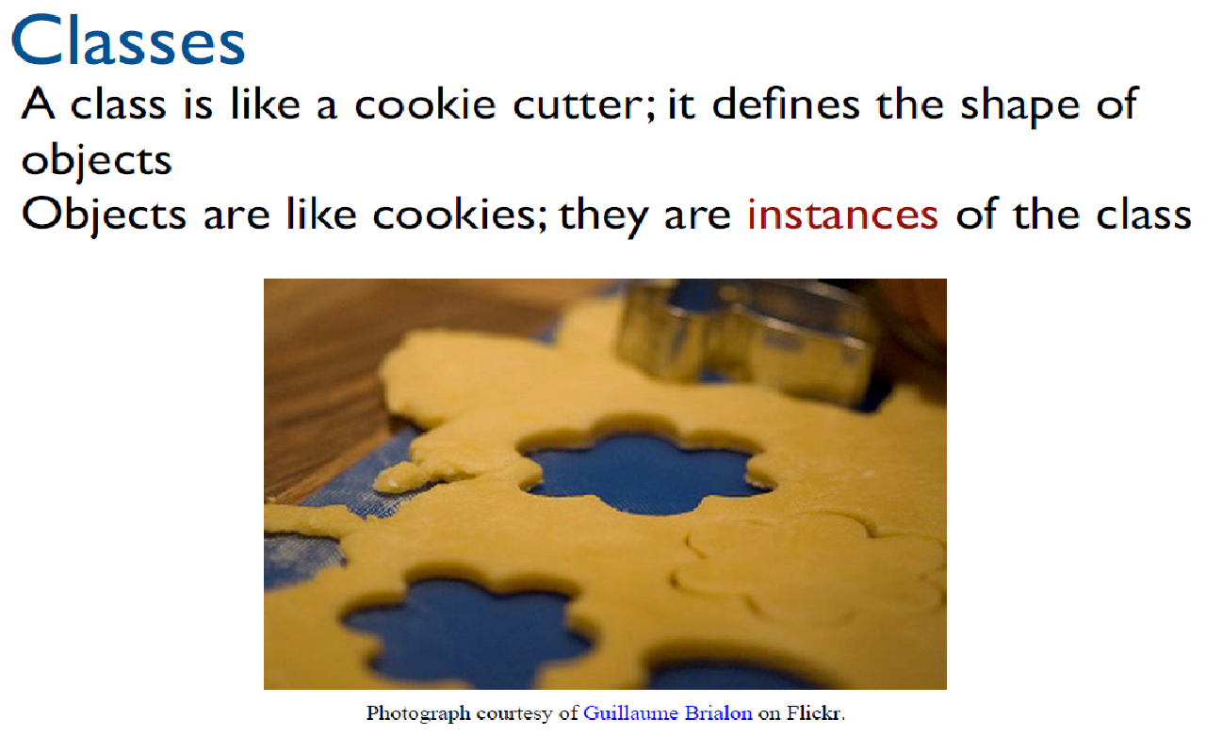
Classes & Objects

Slide 4
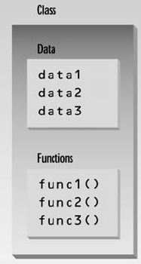
Class Data Members and Member Functions
The data items within a class are called data members or data fields or instance variables
Member functions are functions that are included within a class. Also known as instance functions.

Slide 5
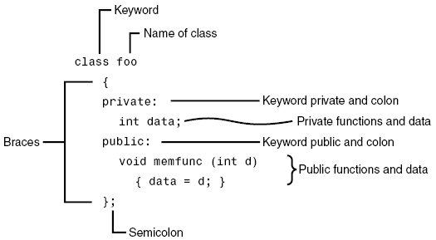
Class in C++ - Example

Slide 6
Object Creation - Instantiation
In C++, you can assign a name when creating an object.
A constructor is invoked when an object is created.
The syntax to create an object using the no-arg constructor is:
ClassName objectName;
Defining objects in this way means creating them. This is also called instantiating them.

Slide 7
Class is a Type
You can use primitive data types to define variables.
You can also use class names to declare object names.
In this sense, a class is an abstract data-type or user-defined data type.

Slide 8
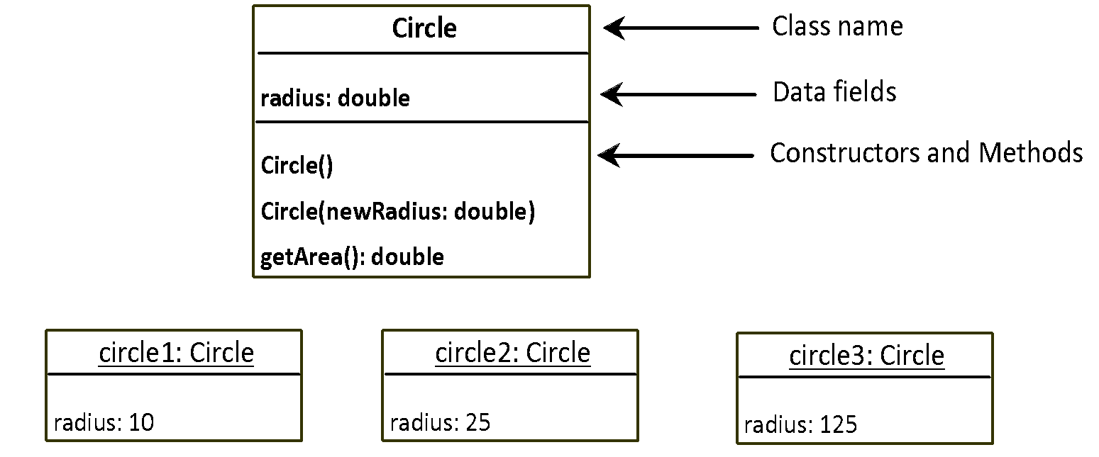
UML Diagram for Class and Object
Notes:
The Unified Modeling Language (UML) is a general-purpose, developmental, modeling language in the field of software engineering that is intended to provide a standard way to visualize the design of a system.

Slide 9
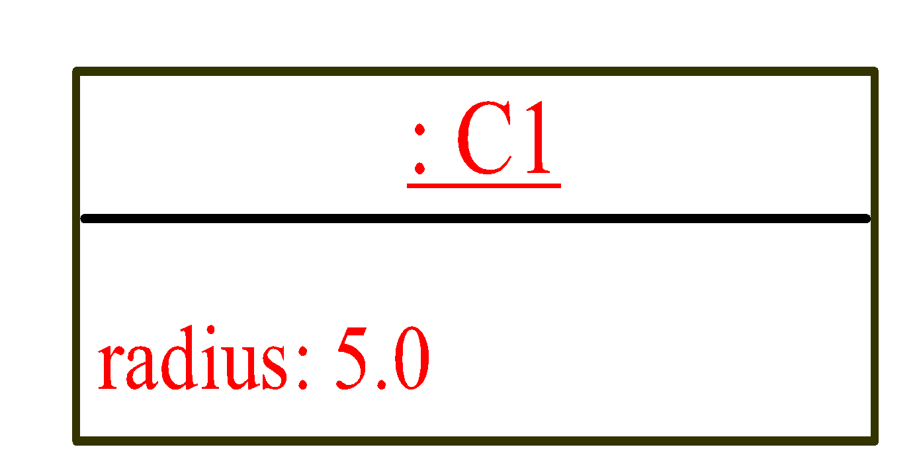
A Simple Program – Object Creation
class Circle
{
private:
double radius;
public:
Circle()
{ radius = 5.0; }
double getArea( )
{ return radius * radius * 3.14159; }
};
C1
Object Instance
Allocate memory for radius
void main()
{
Circle C1;
cout<<“Area of circle = “<<C1.getArea( );
}

Slide 10
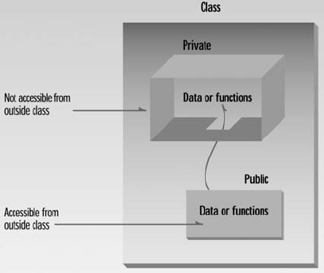
Access Modifiers/Specifier
Access modifiers are used to set access levels for variables, methods, and constructors
private, public, and protected
In C++, default accessibility is private
Notes:
A constructor can be public or private.
If there are multiple constructors of a class, then the constructor being used to construct an object must be public. Although, the constructors not being used to construct objects may still be “Private”

Slide 11
Member Access Specifiers
public
Presents clients with a view of the services the class provides (i.e., interface)
Data and member functions are accessible (outside class)
private
Default access mode
Data only accessible to member functions and friends
private members only accessible through the public class interface using public member functions

Slide 12
Data Hiding - Data Field Encapsulation
A key feature of OOP is data hiding
data is concealed within a class so that it cannot be accessed mistakenly by functions outside the class.
To prevent direct modification of class attributes (outside the class), the primary mechanism for hiding data is to put it in a class and make it private using private keyword. This is also known as data field encapsulation.

Slide 13
Hidden from Whom?
Data hiding means hiding data from parts of the program that don’t need to access it. More specifically, one class’s data is hidden from other classes.
Data hiding is designed to protect well-intentioned programmers from mistakes.

Slide 14
A Simple Program – Accessing Member Function
class Circle
{
private:
double radius;
public:
Circle()
{ radius = 5.0; }
double getArea()
{ return radius * radius * 3.14159; }
};
C1
Object Instance
Allocate memory for radius
void main()
{
Circle C1;
//C1.radius = 10; can’t access private member outside the class
cout<<“Area of circle = “<<C1.getArea();
}

Slide 15
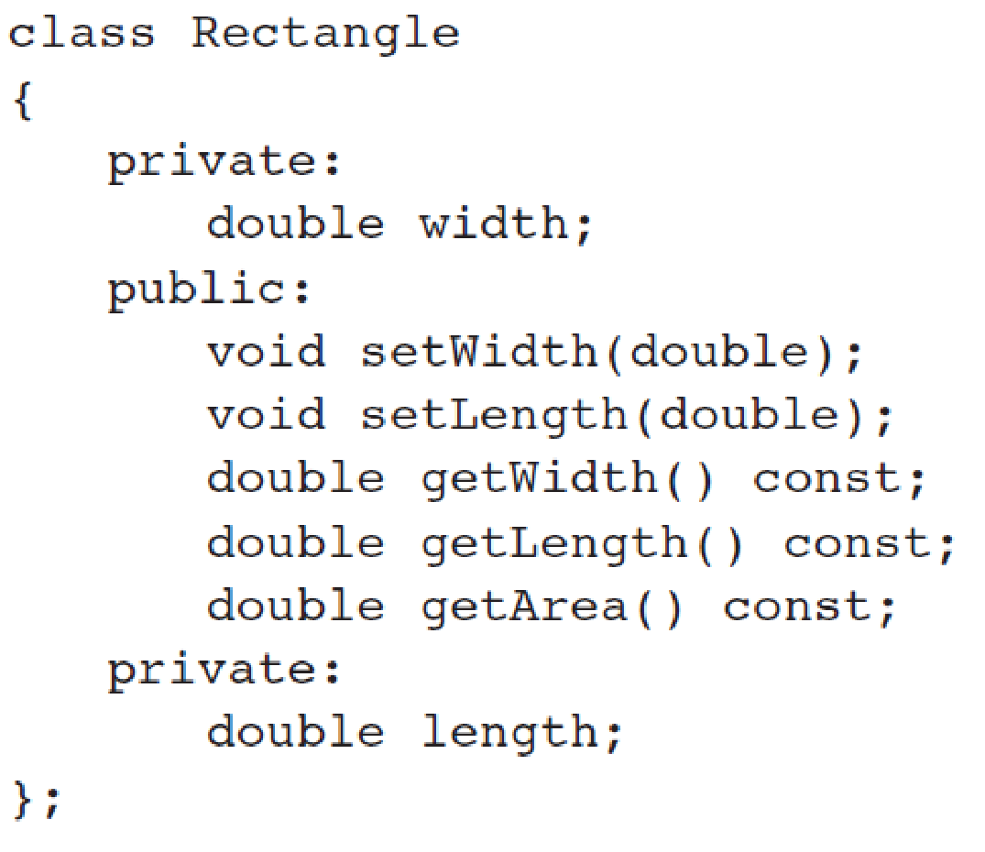
Accessors and Mutators(Getters & Setters)
Accessors: member function only reads/gets value from a class’s member variable but does not change it.
Mutators: member function that stores a value in member variable

Slide 16
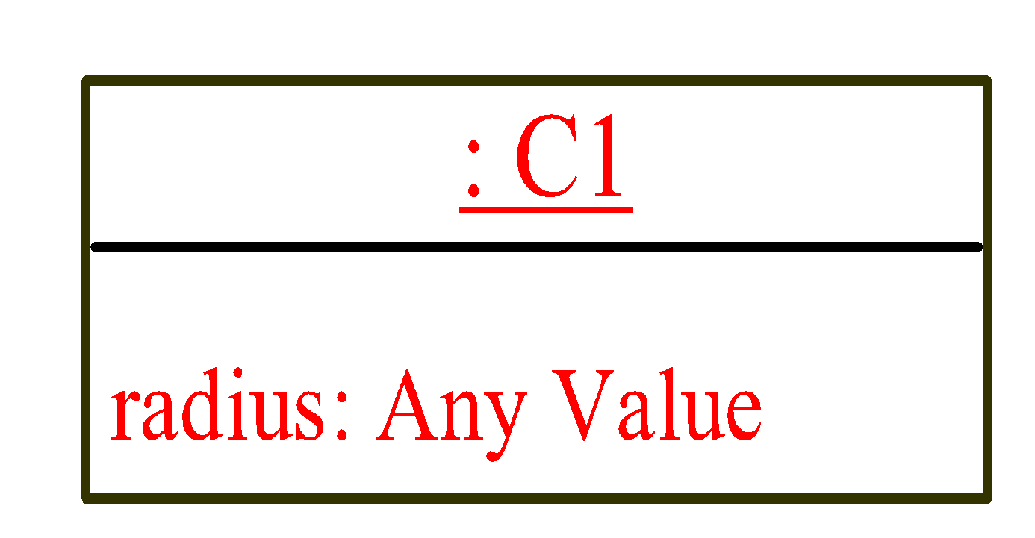
A Simple Program – Default Constructor
class Circle
{
private:
double radius;
public:
double getArea()
{ return radius * radius * 3.14159; }
};
C1
Object Instance
//Default Constructor
Circle()
{ }
// No Constructor Here
Allocate memory for radius
void main()
{
Circle C1;
//C1.radius = 10; can’t access private member outside the class
cout<<“Area of circle = “<<C1.getArea();
}

Slide 17
The default constructor (provided by compiler) is always public.
Programmer can specify a constructor to be private (no use) or public

Slide 18
Object Member Access Operator
After object creation, its data and functions can be accessed (invoked) using:
The . operator, also known as the object member access operator.
objectName.dataField references a data field in the object
objectName.function( ) invokes a function on the object

Slide 19
Inline/Out-of-Line Member Functions
Inline functions:
are defined within the body of the class definition.
Out-of-line functions:
are declared within the body of the class definition and defined outside.

Slide 20
Inline/Out-of-Line Member Functions
If a member function is defined outside the class
Scope resolution operator (::) and class name are needed
Defining a function outside a class does not change it being public or private
returnType ClassName::MemberFunctionName( ){
…
}

Slide 21
Member Functions Separating Declaration from Implementation
class Circle
{
private:
double radius;
public:
Circle(double radius)
{ this->radius = radius; }
double getArea( ); // Not implemented yet
};
double Circle::getArea()
{ return this->radius * radius * 3.14159; }
Class must define a no-argument constructor too….
void main()
{
Circle C1(99.0);
cout<<“Area of circle = “<<C1.getArea();
}

Slide 22
1 // Fig. 6.3: fig06_03.cpp
2 // Time class.
3 #include <iostream>
4
5 using std::cout;
6 using std::endl;
7
8 // Time abstract data type (ADT) definition
9 class Time {
10 public:
11 Time(); // constructor
12 void setTime( int, int, int ); // set hour, minute, second
13 void printMilitary(); // print military time format
14 void printStandard(); // print standard time format
15 private:
16 int hour; // 0 – 23
17 int minute; // 0 – 59
18 int second; // 0 – 59
19 };
20
Note the :: preceding the function names.
21 // Time constructor initializes each data member to zero.
22 // Ensures all Time objects start in a consistent state.
23 Time::Time() { hour = minute = second = 0; }
24
25 // Set a new Time value using military time. Perform validity
26 // checks on the data values. Set invalid values to zero.
27 void Time::setTime( int h, int m, int s )
28 {
29 hour = ( h >= 0 && h < 24 ) ? h : 0;
30 minute = ( m >= 0 && m < 60 ) ? m : 0;
31 second = ( s >= 0 && s < 60 ) ? s : 0;
32 }

Slide 23
33
34 // Print Time in military format
35 void Time::printMilitary()
36 {
37 cout << ( hour < 10 ? "0" : "" ) << hour << ":"
38 << ( minute < 10 ? "0" : "" ) << minute;
39 }
40
41 // Print Time in standard format
42 void Time::printStandard()
43 {
44 cout << ( ( hour == 0 || hour == 12 ) ? 12 : hour % 12 )
45 << ":" << ( minute < 10 ? "0" : "" ) << minute
46 << ":" << ( second < 10 ? "0" : "" ) << second
47 << ( hour < 12 ? " AM" : " PM" );
48 }
49

Slide 24
Private Member Functions
Private Member Functions:
Only accessible (callable) from member functions of the class
No direct access possible (with object instance of the class)
Can be: inline / out-of-line

Slide 25
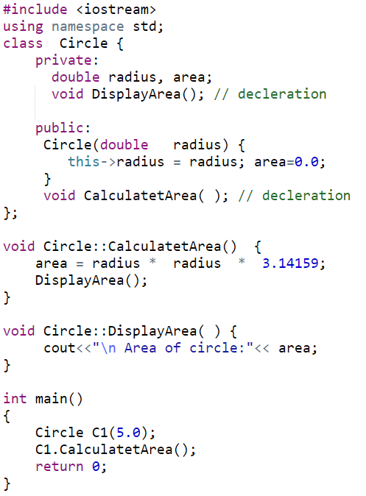
Private Member Functions (out-of-line)

Slide 26
Object Construction with Arguments
The syntax to declare an object using a constructor with arguments is:
ClassName objectName(arguments);
For example, the following declaration creates an object named circle1 by invoking the Circle class’s constructor with a specified radius 5.5.
Circle circle1(5.5);

Slide 27

A Simple Program – Constructor with Arguments
class Circle
{
private:
double radius;
public:
Circle( ) {}
Circle(double rad)
{ radius = rad; }
double getArea()
{ return radius * radius * 3.14159; }
};
C1
Object Instance
Allocate memory for radius
void main()
{
Circle C1(9.0);
//C1.radius = 10; can’t access private member outside the class
cout<<“Area of circle = “<<C1.getArea();
}

Slide 28
Output of the following Program?
class Circle
{
private:
double radius;
public:
Circle( ) { }
Circle(double rad)
{ radius = rad; }
double getArea()
{ return radius * radius * 3.14159; }
};
void main()
{
Circle C1;
cout<<“Area of circle = “<<C1.getArea();
}

Slide 29
const Member Functions
const Member Functions: Read-only functions cannot modify object’s data members

Slide 30
Constant Functions
class Circle
{
private:
double radius;
public:
Circle ()
{ radius = 1; }
Circle(double rad)
{ radius = rad; }
double getArea() const
{ return radius * radius * 3.14159; }
};
const member function cannot update/change object’s data
void main()
{
Circle C2(8.0);
Circle C1;
cout<<“Area of circle = “<<C1.getArea();
}

Slide 31
const Objects
const Object: Read-only objects
Object data members can only be read, NO write/update of data member allowed
Requires all member functions be const (except constructors and destructors)
const object must be initialized (using constructors) at the time of object creation

Slide 32
const Objects
const property of an object goes into effect after the constructor finishes executing and ends before the class's destructor executes
– So the constructor and destructor can modify the object

Slide 33
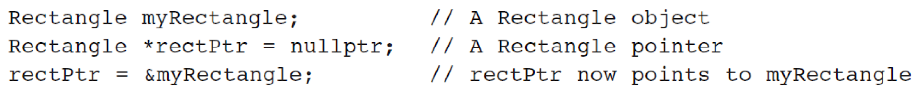
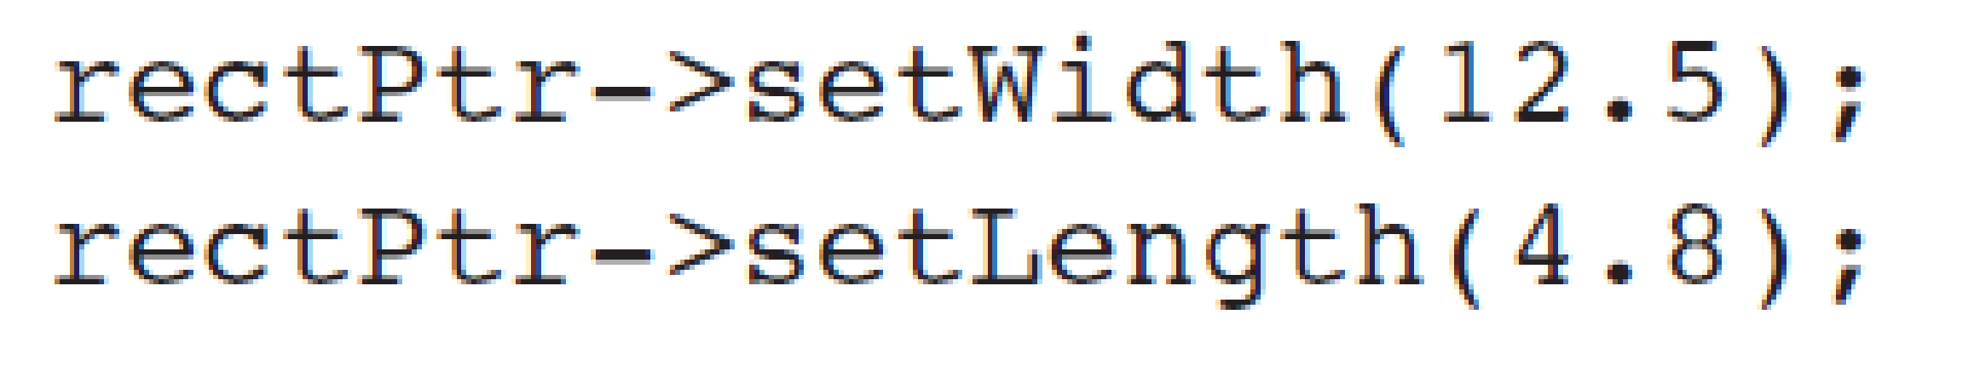
Pointers to Objects
You can also define pointers to class objects
You can use * and . operators OR -> to access members:

Slide 34
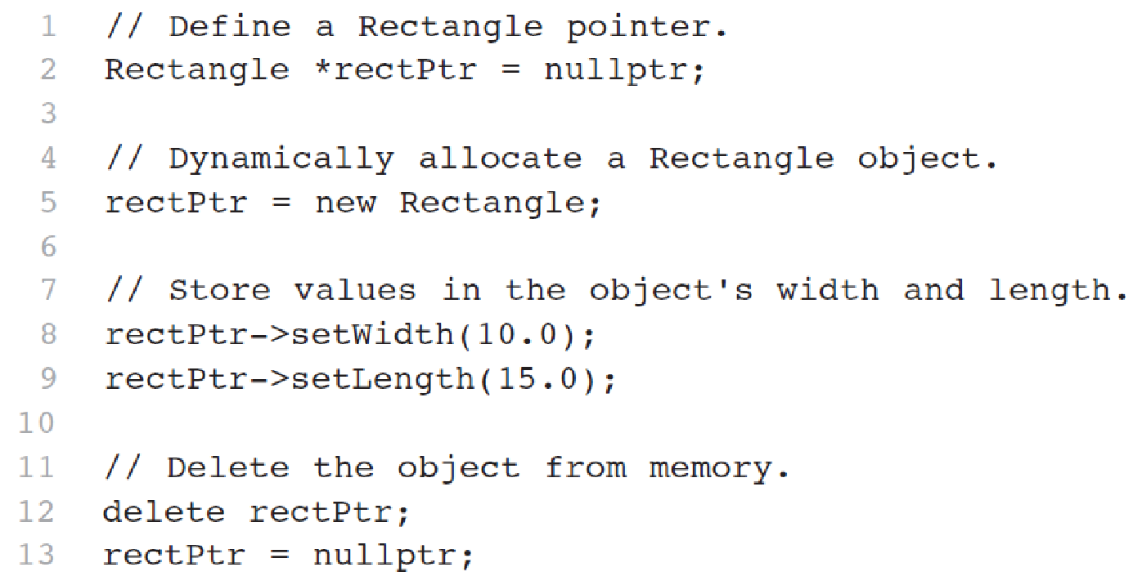
Pointers to Objects
Dynamic Object Creation

Slide 35
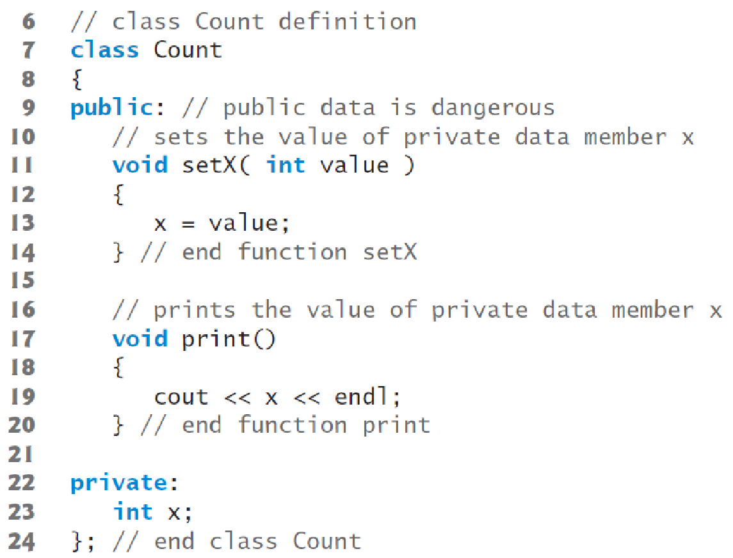
Reference to Objects
Reference is an alias to an existing object

Slide 36
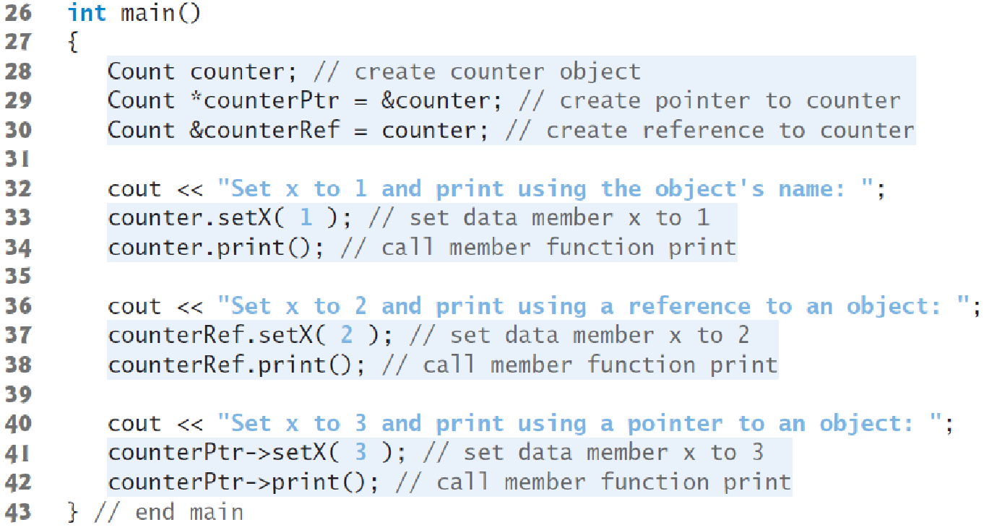
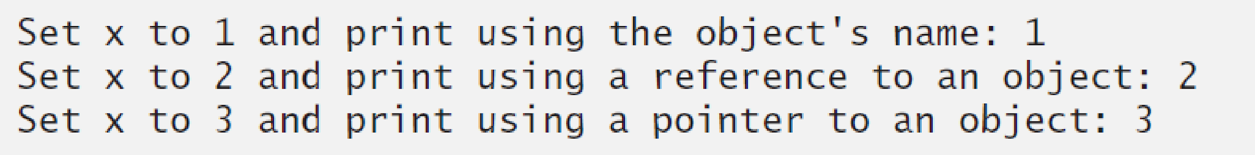
Reference to Objects

Slide 37
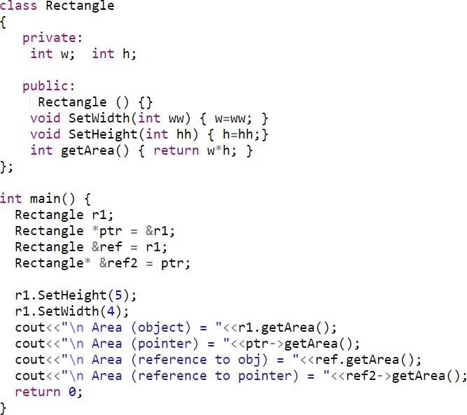

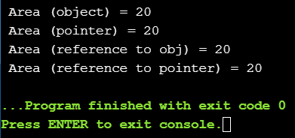
Reference and Pointers to Objects

Slide 38
Interface vs Implementation
Separating interface from implementation
Makes it easier to modify programs
Header files
Contains class definitions and function prototypes
Source-code files
Contains member function definitions

Slide 39
1 // Fig. 6.5: time1.h
2 // Declaration of the Time class.
3 // Member functions are defined in time1.cpp
4
5 // prevent multiple inclusions of header file
6 #ifndef TIME1_H
7 #define TIME1_H
8
If time1.h (TIME1_H) is not defined (#ifndef) then it is loaded (#define TIME1_H). If TIME1_H is already defined, then everything up to #endif is ignored.
This prevents loading a header file multiple times.
9 // Time abstract data type definition
10 class Time {
11 public:
12 Time(); // constructor
13 void setTime( int, int, int ); // set hour, minute, second
14 void printMilitary(); // print military time format
15 void printStandard(); // print standard time format
16 private:
17 int hour; // 0 - 23
18 int minute; // 0 - 59
19 int second; // 0 - 59
20 };
21
22 #endif
Notes:
#ifndef checks whether the given token has been #defined earlier in the file or in an included file; if not, it includes the code between it and the closing #else or, if no #else is present, #endif statement.

Slide 40
23 // Fig. 6.5: time1.cpp
24 // Member function definitions for Time class.
25 #include <iostream>
26
27 using std::cout;
Source file uses #include to load the header file
28
29 #include "time1.h"
30
31 // Time constructor initializes each data member to zero.
32 // Ensures all Time objects start in a consistent state.
33 Time::Time() { hour = minute = second = 0; }
34
35 // Set a new Time value using military time. Perform validity
36 // checks on the data values. Set invalid values to zero.
37 void Time::setTime( int h, int m, int s )
38 {
39 hour = ( h >= 0 && h < 24 ) ? h : 0;
40 minute = ( m >= 0 && m < 60 ) ? m : 0;
41 second = ( s >= 0 && s < 60 ) ? s : 0;
Source file contains function definitions
42 }
43
44 // Print Time in military format
45 void Time::printMilitary()
46 {
47 cout << ( hour < 10 ? "0" : "" ) << hour << ":"
48 << ( minute < 10 ? "0" : "" ) << minute;
49 }
50
51 // Print time in standard format
52 void Time::printStandard()
53 {
54 cout << ( ( hour == 0 || hour == 12 ) ? 12 : hour % 12 )
55 << ":" << ( minute < 10 ? "0" : "" ) << minute
56 << ":" << ( second < 10 ? "0" : "" ) << second
57 << ( hour < 12 ? " AM" : " PM" );
58 }

Slide 41
Constructors
A constructor is a special function used to create an object.
Constructor has exactly the same name as the defining class
Constructors can be overloaded (i.e., multiple constructors with different signatures) [Purpose: making it easy to construct objects with different initial data values).
A class may be declared without constructors. In this case, a no-argument constructor with an empty body is implicitly declared in the class known as default constructor
Note: Default constructor is provided automatically only if no constructors are explicitly declared in the class.

Slide 42
Constructors’ Properties
must have the same name as the class itself.
do not have a return type—not even void.
play the role of initializing objects.

Slide 43
Constructors (Summary)
Constructor is a function in every class which is called when class creates its object
Basically it helps in initializing data members of the class
A class may have multiple constructors

Slide 44
Initializing Objects
Notice that default settings for the three member variables are set in constructor prototype. No names are needed; the defaults are applied in the order the variables are declared.
10 // Time abstract data type definition
11 class Time {
12 public:
13 Time( int = 0, int = 0, int = 0 ); // default constructor
14 void setTime( int, int, int ); // set hour, minute, second
15 void printMilitary(); // print military time format
16 void printStandard(); // print standard time format
17 private:
18 int hour; // 0 - 23
19 int minute; // 0 - 59
20 int second; // 0 - 59
21 };
22
23 #endif
Default Parameters in Constructor
Notes:
A constructor with « Default » parameters can be used as no argument constructor, and set of argument based constructor (1, 2, …n, argumnt based)

Slide 45
Same constructor, used in overloaded style
70
71 int main()
72 {
73 Time t1, // all arguments defaulted
74 t2(2), // minute and second defaulted
75 t3(21, 34), // second defaulted
76 t4(12, 25, 42), // all values specified
77 t5(27, 74, 99); // all bad values specified
78
79 cout << "Constructed with:\n"
80 << "all arguments defaulted:\n ";
81 t1.printMilitary();
82 cout << "\n ";
83 t1.printStandard();
84
85 cout << "\nhour specified; minute and second defaulted:"
86 << "\n ";
87 t2.printMilitary();
88 cout << "\n ";
89 t2.printStandard();
90
91 cout << "\nhour and minute specified; second defaulted:"
92 << "\n ";
93 t3.printMilitary();

Slide 46
Using Destructors
Destructors
Are member function of class
Perform termination housekeeping before the system reclaims the object’s memory
Name is tilde (~) followed by the class name (i.e., ~Time)
Receives no parameters, returns no value
One destructor per class (no overloading)
Destructors cannot be declared const, static
A destructor can be declared virtual or pure virtual
Notes:
const function: That cannot modify class data members
static function: class level function (not assosiated with any object)
volatile function:
virtual function: A C++ virtual function is a member function in the base class that you redefine in a derived class
pure-virtual function: A pure virtual function is a virtual function in C++ for which we need not to write any function definition and only we have to declare it

Slide 47
Destructors (Summary)
Destructors is a function in every class which is called when the object of a class is destroyed
The main purpose of destructor is to remove dynamic memories etc.

Slide 48
7 class CreateAndDestroy {
8 public:
9 CreateAndDestroy( int ); // constructor
10 ~CreateAndDestroy(); // destructor
11 private:
12 int data;
13 };
14
15 #endif

Slide 49
24
25 CreateAndDestroy::CreateAndDestroy( int value )
26 {
27 data = value;
28 cout << "Object " << data << " constructor";
29 }
30
31 CreateAndDestroy::~CreateAndDestroy()
32 { cout << "Object " << data << " destructor " << endl; }

Slide 50
Constructing Arrays of Objects
Complex c_arr[10];
Date date_arr[20];
Issue: There is no way to call argument-based constructors (non-default) for array members

Slide 51
Arrays of Objects and Non-Default Constructors
Trick: declare an array of pointer to objects
Allocate and initialize each object in a loop
Date *dates[31];
for (int day = 0; day < 31; ++day)
{
dates[day] = new Date(3, day, 2020);
}

Slide 52
Default Member-wise Assignment
Assignment operator (=) can be used to assign an object to another object of the same type.
Member-wise assignment: each data member of the object on the right of the assignment operator is assigned individually to the same data member in the object on the left

Slide 53
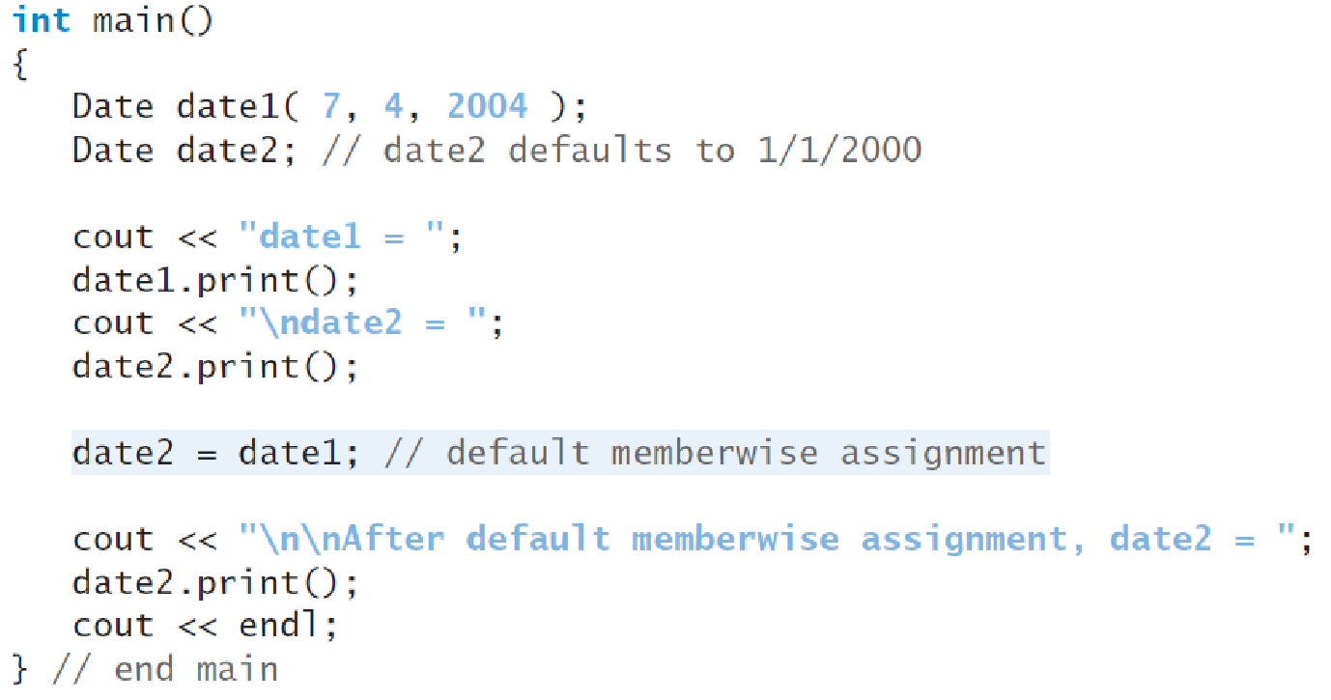
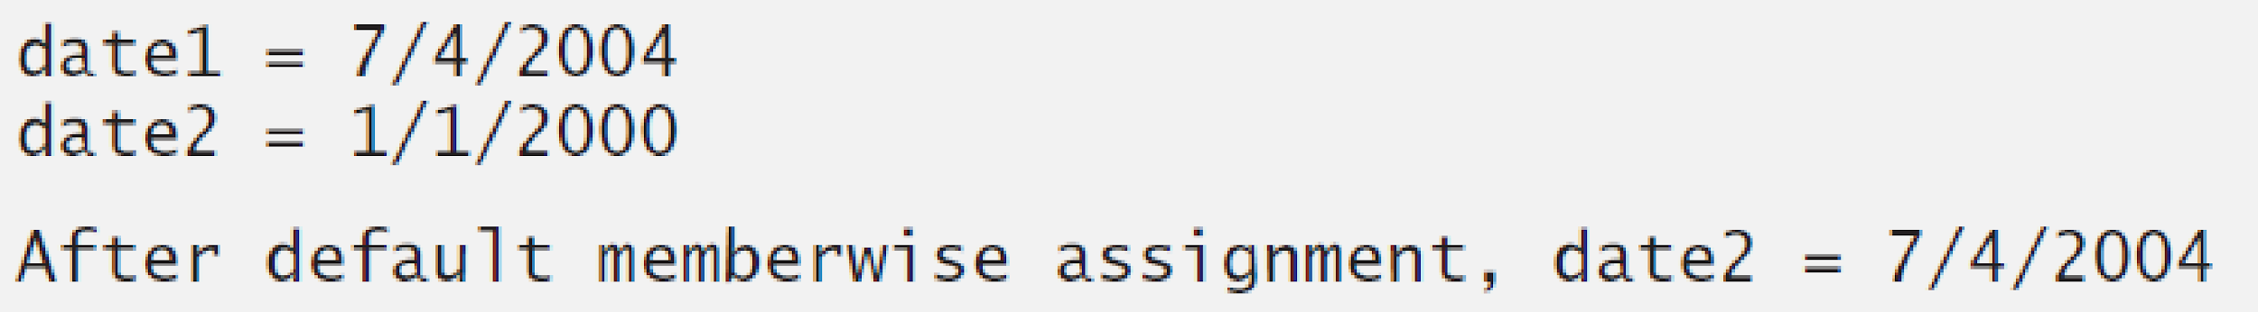

Slide 54
Default copy constructor
A type of constructor that is used to initialize an object with another object of the same type is known as default copy constructor.
It is by default available in all classes
syntax is ClassName(ClassName &Variable)
Notes:
If we don’t define our own copy constructor, the C++ compiler creates a default copy constructor for each class which does a member-wise copy between objects.

Slide 55
Copy Constructor for Class Date
Date::Date(Date &date)
{
// no need to check passed date arg month = date.month;
day = date.day; year = date.year;
}

Slide 56
Copy Constructor: Defining a New Object
Date d1(02,28,2020);
// init 2 local objects from d1
Date d2(d1);// pass by value
Date d3 = d1;// return value
// init a dynamic object from d1
Date* pdate = new Date(d1);
Notes:
Copy constructor is called when a new object is created from an existing object, as a copy of the existing object. Assignment operator is called when an already initialized object is assigned a new value from another existing object.

Slide 57
Copy Constructor:Passing Objects by Value
//copy constructor called for each value arg
unsigned dateDiff(Date d1, Date d2);
...
Date today;
Date d3(02, 21, 2000);
cout << dateDiff(d3, today);

Slide 58
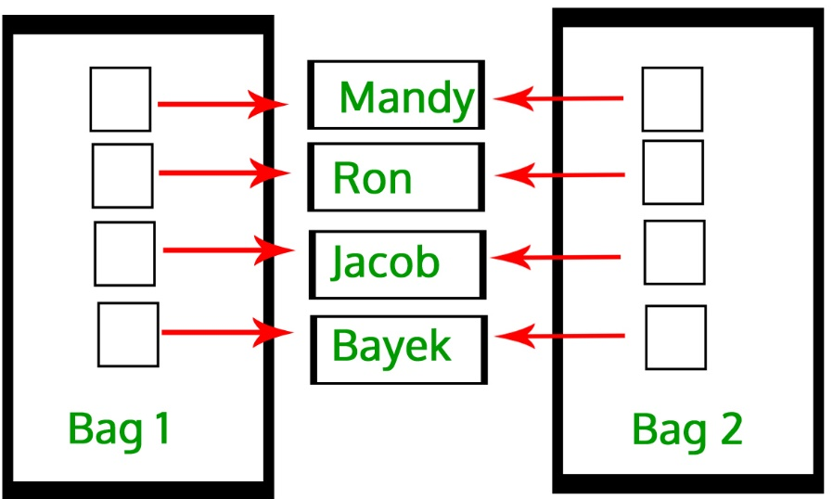
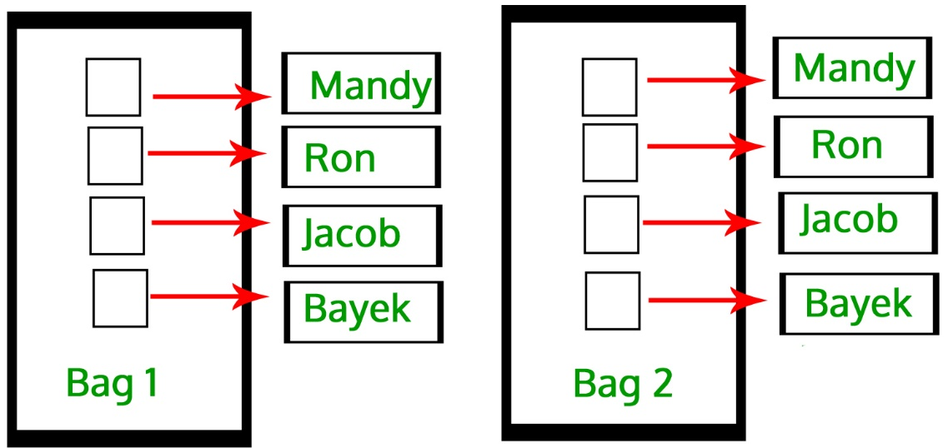
User-defined Copy Constructor, when required?
Default-copy Constructor do only “Shallow Copy”
We need user-defined copy-constructor,
When we need “Deep Copy” (for Dynamic Memory)
Notes:
Useful for dynamic memory or pointers

Slide 59
Shallow Copy
class Demo
{
int a;
int b;
int *p;
public:
Demo()
{
p=new int;
10. }
void setdata(int x,int y,int z)
{
a=x;
b=y;
*p=z;
16. }
void showdata()
{
std::cout << "value of a is : " <<a<< std::endl;
std::cout << "value of b is : " <<b<< std::endl;
std::cout << "value of *p is : " <<*p<< std::endl;
22. }

Slide 60

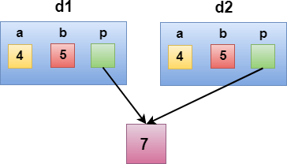
1.
void showdata()
{
std::cout << "value of a is : " <<a<< std::endl;
std::cout << "value of b is : " <<b<< std::endl;
std::cout << "value of *p is : " <<*p<< std::endl;
7. }
8. };
9. int main()
10.{
Demo d1;
d1.setdata(4,5,7);
Demo d2 = d1;
d2.showdata();
return 0;
16.}

Slide 61
Deep Copy
class Demo
{
public:
int a;
int b;
int *p;
7.
Demo()
{
p=new int;
11. }
Demo(Demo &d)
{
a = d.a;
b = d.b;
p = new int;
*p = *(d.p);
18. }
void setdata(int x,int y,int z)
{
a=x;
b=y;
*p=z;
24. }

Slide 62
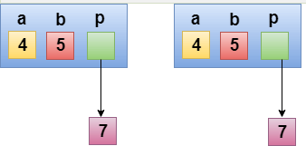
1.
void showdata()
{
std::cout << "value of a is : " <<a<< std::endl;
std::cout << "value of b is : " <<b<< std::endl;
std::cout << "value of *p is : " <<*p<< std::endl;
7. }
8. };
9. int main()
10.{
Demo d1;
d1.setdata(4,5,7);
Demo d2 = d1;
d2.showdata();
return 0;
16.}

Slide 63
static, const, and this Pointer

Slide 64
static Class Variables
Two-Step Procedure:
Declare (Inside Class):
Define (Outside Class):
static int radius; int Circle::radius=2;
static Variables
Default Initialization: 0 or Null (for pointers)
Initialization: user defined value
Initialization is made just once, at compile time.
Accessibility: Private or Public

Slide 65
Public static Class Variables
Can be accessed using Class name:
cout<<Employee::count;
Can be accessed via any class’ object:
cout<<e1.count;
Can be accessed via Non-Static member functions:
cout<<e1.getCount();
Can be accessed via Static member functions:
cout<<Employee::Stat_getCount(); cout<<e1.Stat_getCount(); //public static

Slide 66
Private static Class Variables
Cannot be accessed using Class name:
// ERROR 🡪 cout<<Employee::count;
Cannot be accessed via class' object:
// ERROR 🡪 cout<<e1.count;
Can be accessed via Non-Static member functions:
cout<<e1.getCount();
Can be accessed via Static member functions:
cout<<Employee::Stat_getCount(); cout<<e1.Stat_getCount(); //public static

Slide 67
static Class Functions
Non-static function:
Can access: static/non-static data members
and static/non-static methods
Static functions:
Can access: static data and static functions
Cannot access: non-static data, non-static functions, and this pointer

Slide 68
Public static Class Functions
–Can be invoked using class’s any object:
cout<<e1.getCount();
–Can be invoked using Class name:
cout<<Employee::getCount();

Slide 69
Private static Class Functions
–Cannot be invoked using class’s object
//ERROR 🡪 cout<<e1.getCount();
–Cannot be invoked using Class name
//ERROR 🡪 cout<<Employee::getCount();
–Can be invoked within Class:
Static member functions
Non-Static member functions

Slide 70
// Fig. 7.9: employ1.h
// An employee class
#ifndef EMPLOY1_H
#define EMPLOY1_H
5
class Employee {
public:
Employee( const char*, const char* ); 9
10
11
12
13
14
15
private:
char *firstName;
char *lastName;
19
20
21
22 };
23
24 #endif
// constructor
~Employee();
const char *getFirstName() const;
const char *getLastName() const;
// destructor
// return first name
// return last name
// static member function
static int getCount(); // return # objects instantiated
static member function and
variable declared.
// static data member
static int count; // number of objects instantiated

Slide 71
// Fig. 7.9: employ1.cpp
// Member function definitions for class Employee
#include <iostream>
28
29 using std::cout;
30 using std::endl;
31
static data member count and function getCount( ) initialized at file scope (required).
32 #include <cstring>
#include <cassert>
#include "employ1.h"
35
36 // Initialize the static data member
37 int Employee::count = 0;
38
// Define the static member function that
// returns the number of employee objects instantiated.
int Employee::getCount() { return count; }
Note the use of assert to test for memory allocation.
42
43 // Constructor dynamically allocates space for the
// first and last name and uses strcpy to copy
// the first and last names into the object
Employee::Employee( const char *first, const char *last )
{
firstName = new char[ strlen( first ) + 1 ];
assert( firstName != 0 ); // ensure memory allocated
strcpy( firstName, first );
51
52
53
54
static data member count changed when a constructor/destructor called.
lastName = new char[ strlen( last ) + 1 ];
assert( lastName != 0 ); // ensure memory allocated strcpy( lastName, last );
++count; // increment static count of employees
55
56

Slide 72
57
58
59 }
60
61 // Destructor deallocates dynamically allocated memory
cout << "Employee constructor for " << firstName
<< ' ' << lastName << " called." << endl;
Employee::~Employee()
{
static data member count changed when a constructor/destructor called.
64
cout << "~Employee() called for " << firstName
65
66
67
<< ' ' << lastName << endl;
delete [] firstName; delete [] lastName;
// recapture memory
// recapture memory
Count decremented because of destructor calls from delete.
68
--count;
// decrement static count of employees
69 }
70
// Return first name of employee
const char *Employee::getFirstName() const
{
// Const before return type prevents client from modifying
// private data. Client should copy returned string before
// destructor deletes storage to prevent undefined pointer.
return firstName;
78 }
79
// Return last name of employee
const char *Employee::getLastName() const
{
// Const before return type prevents client from modifying
// private data. Client should copy returned string before
// destructor deletes storage to prevent undefined pointer.
return lastName;
87 }

Slide 73
88 // Fig. 7.9: fig07_09.cpp
// Driver to test the employee class
#include <iostream>
91
using std::cout;
using std::endl;
94
95 #include "employ1.h"
96
int main()
{
99
100
101
Employee *e1Ptr = new Employee( "Susan", "Baker" );
Employee *e2Ptr = new Employee( "Robert", "Jones" );
104
105 cout << "Number of employees after instantiation is " 106
107
cout << "\n\nEmployee 1: "
<< e1Ptr->getFirstName()
<< " " << e1Ptr->getLastName()
<< "\nEmployee 2: "
<< e2Ptr->getFirstName()
113
114
If no Employee objects exist getCount must be accessed using the class name and (::).
count incremented because of constructor calls from new.
Number of employees before instantiation is 0
cout << "Number of employees before instantiation is "
<< Employee::getCount() << endl; //
e2Ptr->getCount() or Employee::getCount() would also work.
use class name
Number of employees after instantiation is 2
<< e1Ptr->getCount();
Employee constructor for Susan Baker called. Employee constructor for Robert Jones called.
Employee 1: Susan Baker
Employee 2: Robert Jones
<< " " << e2Ptr->getLastName() << "\n\n";
115 | delete e1Ptr; | // recapture memory
116 | e1Ptr = 0;
117 | delete e2Ptr; | // recapture memory
118 | e2Ptr = 0;
~Employee() called for Susan Baker
~Employee() called for Robert Jones

Slide 74
119
120 | cout << "Number of employees | after deletion is "
121 | << Employee::getCount() | << endl;
122
123 return 0;
count back to zero.
124 }
Number of employees before instantiation is 0 Employee constructor for Susan Baker called. Employee constructor for Robert Jones called. Number of employees after instantiation is 2
Employee 1: Susan Baker Employee 2: Robert Jones
~Employee() called for Susan Baker
~Employee() called for Robert Jones
Number of employees after deletion is 0

Slide 75
const Class Members
As with member functions, data members can also be const
Member Initializer List:
Can be used to initialize both const and non-const data members
consts and references must be initialized using member initializer

Slide 76
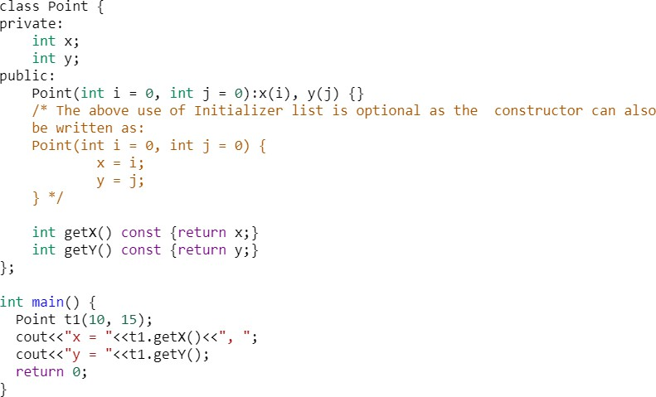

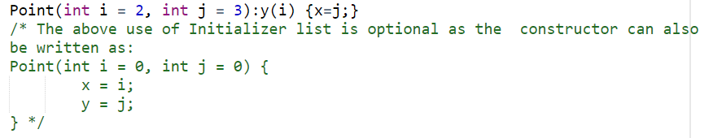
Member Initializer List (Non-const Members)

Slide 77
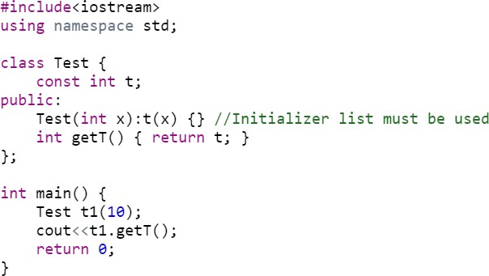
Member Initializer List (non-static const)

Slide 78
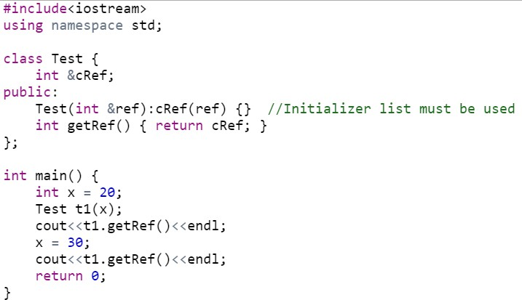
Member Initializer List (References)

Slide 79
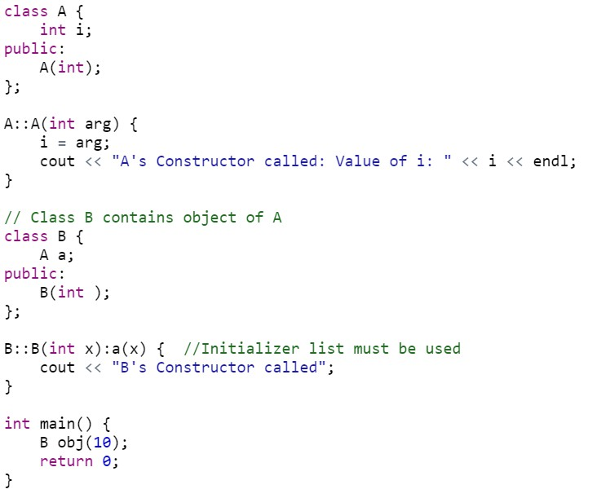
Member Initializer List (member object, no default constructor)

Slide 80
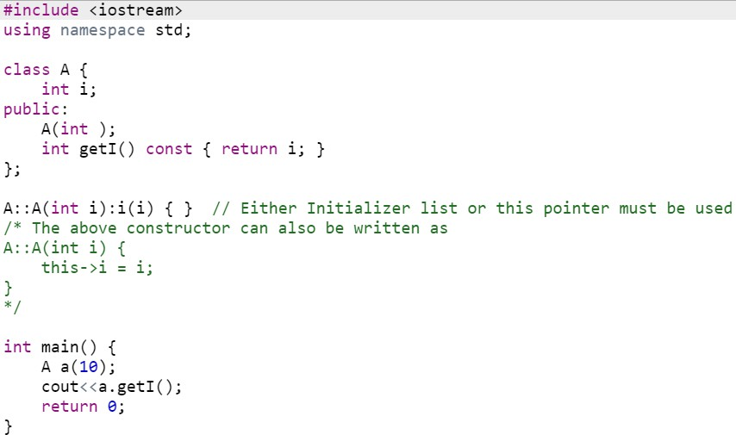
Member Initializer List (parameter name same as data member)

Slide 81
The this Pointer
this keyword is a special built-in pointer (constant pointer) that references to the calling object.
this pointer is passed as a hidden argument to all non-static member function and is available as a local variable within the body of all non-static functions.
Not part of the object itself (this pointer is not reflected with sizeof(object))
Can be used to access instance variables within
constructors and member functions

Slide 82
Using the this Pointer
Examples using this
For a member function print data member x, either
this->x;
or
(*this).x
Cascaded member function calls:
Function returns a reference pointer to the same object
{ return *this; }
Other functions can operate on that pointer

Slide 83
Using the this Pointer
Example of cascaded member function calls:
Member functions setHour, setMinute, and setSecond all return *this (reference to an object)
For object t, consider:
t.setHour(1).setMinute(2).setSecond(3);
– Executes t.setHour(1), returns *this (reference to object) and the expression becomes
t.setMinute(2).setSecond(3);
– Executes t.setMinute(2), returns reference and becomes
t.setSecond(3);
– Executes t.setSecond(3), returns reference and becomes
t; (Has no effect)

Slide 84
1 // Fig. 7.7: fig07_07.cpp
// Using the this pointer to refer to object members.
#include <iostream>
4
using std::cout;
using std::endl;
7
class Test {
public:
Test( int = 0 );
void print() const;
private:
int x;
14 };
15
16 Test::Test( int a ) { x = a; } // constructor 17
void Test::print() const // ( ) around *this required
{
// default constructor
Printing x directly.
Print x using the arrow ->
operator off the this pointer.
20 | cout | << | " | x = | " | << x
21 |  | << | "\n | this->x | = | " << | this->x
22
23 }
24
int main()
{
Test testObject( 12 );
28
29
30
31
32 }
<< "\n(*this).x = " << ( *this ).x << endl;
Printing x using the dot (.) operator. Parenthesis
required because dot operator has higher precedence than *. Without, interpreted incorrectly as *(this.x).
testObject.print();
return 0;

Slide 85
x | = | 12
this->x | = | 12
(*this).x | = | 12
All three methods have the same result.

Slide 86
// Fig. 7.8: time6.h
// Cascading member function calls. 3
// Declaration of class Time.
// Member functions defined in time6.cpp
#ifndef TIME6_H
#define TIME6_H
8
class Time {
public:
Time( int = 0, int = 0, int = 0 );
12
13
14
15
16
17
18
19
20
21
22
23
24
void printMilitary() const;
void printStandard() const;
private:
28
29
30
31 };
32
33 #endif
// default constructor
// set functions
Time &setTime( int, int, int ); // set hour, minute, second
Time &setHour( int ); Time &setMinute( int ); Time &setSecond( int );
// set hour
// set minute
// set second
Notice the Time & - function
returns a reference to a Time
object.
Specify object in function definition.
// get functions (normally declared const)
int getHour() const; int getMinute() const; int getSecond() const;
// return hour
// return minute
// return second
// print functions (normally declared const)
// print military time
// print standard time
int hour; int minute; int second;
// 0 - 23
// 0 - 59
// 0 - 59

Slide 87
34 // Fig. 7.8: time.cpp
35 // Member function definitions for Time class.
36 #include <iostream>
37
38 using std::cout;
39
40 #include "time6.h"
41
// Constructor function to initialize private data.
// Calls member function setTime to set variables.
// Default values are 0 (see class definition).
Time::Time( int hr, int min, int sec )
{ setTime( hr, min, sec ); } 47
// Set the values of hour, minute, and second.
Time &Time::setTime( int h, int m, int s )
Returning *this enables
cascading function calls
50 {
51
52
53
setHour( h ); setMinute( m ); setSecond( s );
54
55 }
56
// Set the hour value
Time &Time::setHour( int h )
{
60 hour = ( h >= 0 && h < 24 ) ? h : 0;
61
62 return *this; // enables cascading
63 }
64
return *this;
// enables cascading

Slide 88
// Set the minute value
Time &Time::setMinute( int m )
{
68 minute = ( m >= 0 && m < 60 ) ? m : 0; 69
70 return *this; // enables cascading
71 }
72
73 // Set the second value
Returning *this enables cascading function calls
74 Time &Time::setSecond( int s )
75 {
76
77
second = ( s >= 0 && s < 60 ) ? s : 0;
return *this; // enables cascading
78
79 }
80
// Get the hour value
int Time::getHour() const { return hour; } 83
// Get the minute value
int Time::getMinute() const { return minute; } 86
// Get the second value
int Time::getSecond() const { return second; } 89
// Display military format time: HH:MM
void Time::printMilitary() const
{
93 cout << ( hour < 10 ? "0" : "" ) << hour << ":"
94 << ( minute < 10 ? "0" : "" ) << minute;

Slide 89
95 }
96
// Display standard format time: HH:MM:SS AM (or PM)
void Time::printStandard() const
{
printStandard does not return a reference to an object.
100 cout << ( ( hour == 0 || hour == 12 ) ? 12 : hour % 12 )
101 << ":" << ( minute < 10 ? "0" : "" ) << minute
102 << ":" << ( second < 10 ? "0" : "" ) << second
103 << ( hour < 12 ? " AM" : " PM" );
104 }
105 // Fig. 7.8: fig07_08.cpp
106 // Cascading member function calls together
107 // with the this pointer
108 #include <iostream>
Notice cascading function calls.
109
110 using std::cout;
111 using std::endl; 112
113 #include "time6.h"
114
115 int main()
116 {
117 Time t;
118
119 t.setHour( 18 ).setMinute( 30 ).setSecond( 22 );
cout << "Military time: ";
t.printMilitary();
cout << "\nStandard time: ";
t.printStandard();
Cascading function calls. printStandard must be called after setTime because printStandard does not return a reference to an object. t.printStandard().setTime(); would cause an
124
error.
cout << "\n\nNew standard time: ";
t.setTime( 20, 20, 20 ).printStandard();

Slide 90
127
cout << endl;
128
129
return 0;
130
}
Military time: 18:30 Standard time: 6:30:22 PM
New standard time: 8:20:20 PM

Slide 91
Thankyou

